Slide 1

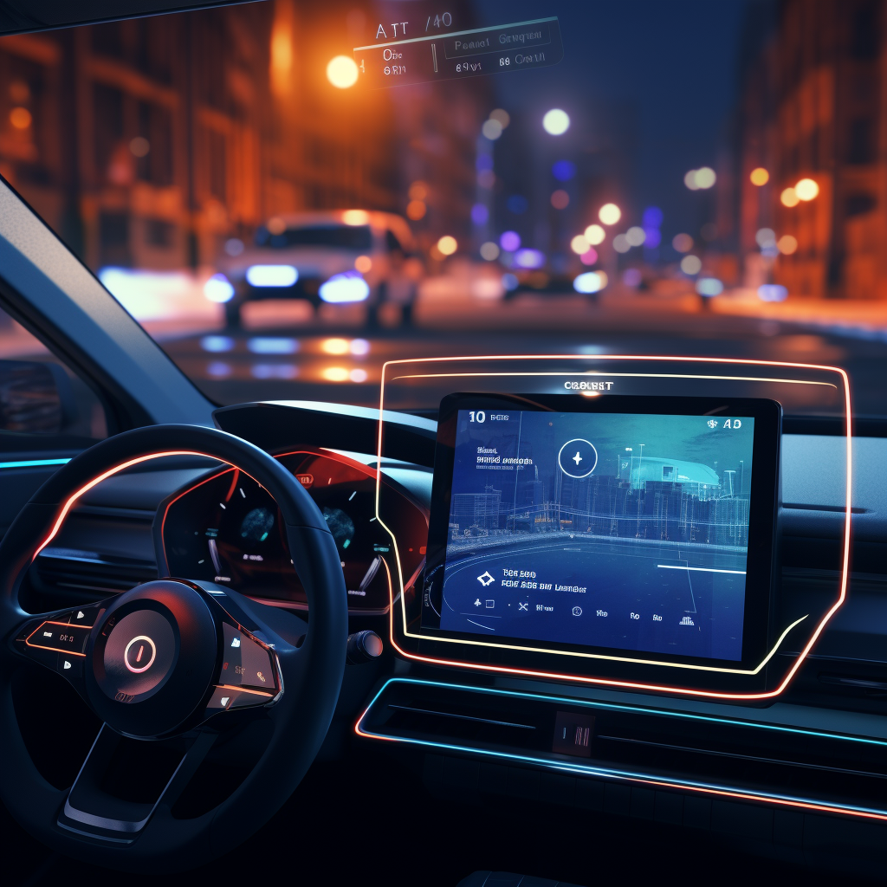
Enable Blind LLMs with Vision
Visionary Co-Driver: LLMs Enhance Driver Perception of Potential Risks with AR-HUD
---My Summer Research Summary
王杰，04/06/2024
Advisor: 向为教授 Prof. Wei Xiang
Mentor: 黄莹莹 Yingying Huang
Github: Summer_Research_2023
Notes:
我们为什么做这个工作，我们做这个工作有什么价值，架构逻辑要更清楚

Slide 2

Content
Visionary Co-Driver: LLMs Enhance Driver Perception of Potential Risks with AR-HUD
Project Intuition
Model Selection
System Design
User Study
Failure and Success
Research Reflection

Slide 3
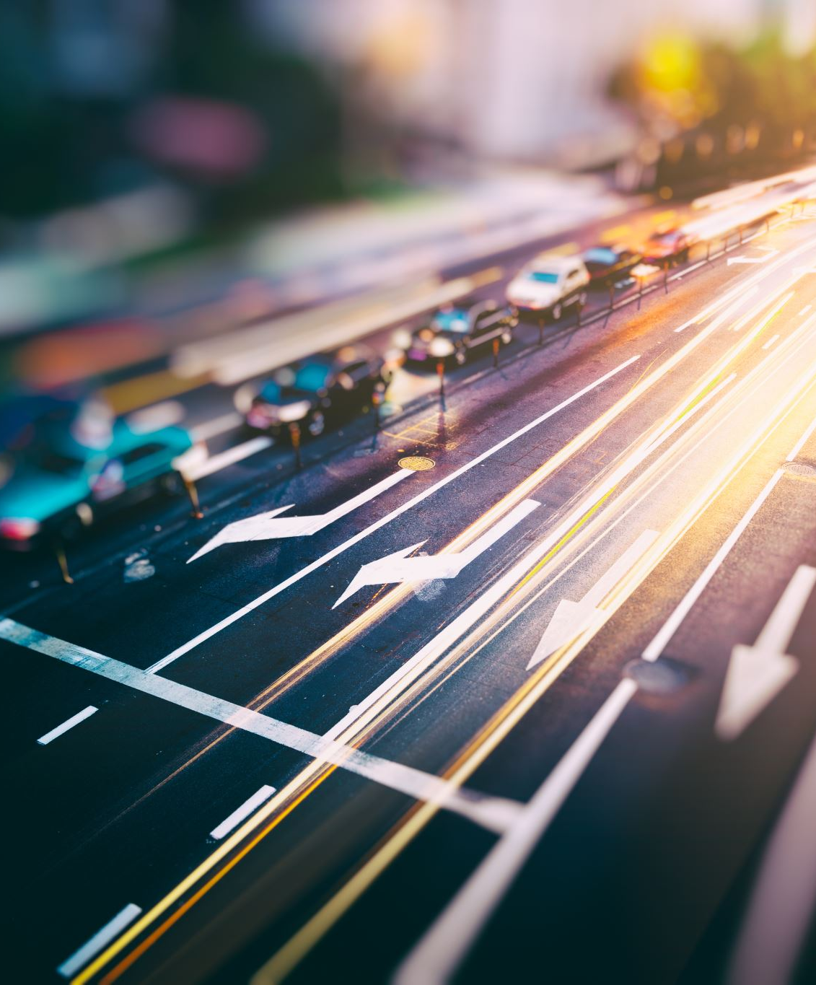
Intuition: Corner cases are countless, but LLM has logic
Visionary Co-Driver
Road scene understanding is a relative complex and important topic in autonomous driving field.
Traditional approach like driving risk field or object detection is useful and practical, but they can’t cover all the possibilities in the real-world scenario (Too much annoying if-statements).
Solving it in a brand-new way is my intuitive study interest, because I saw the potential capability within LLM to be a co-pilot, helping drivers to recognize and avoid those potential risk.

Slide 4
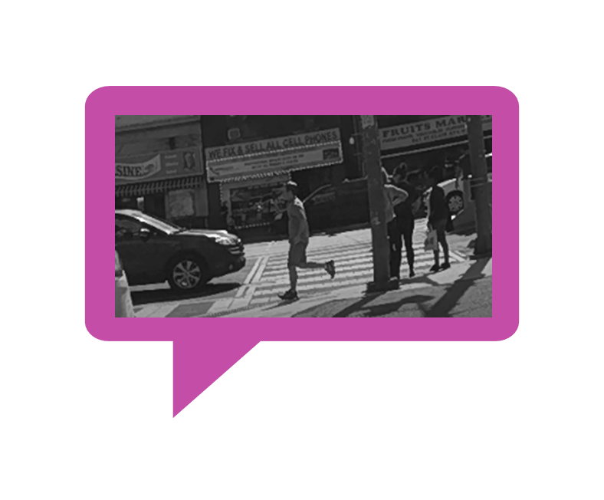

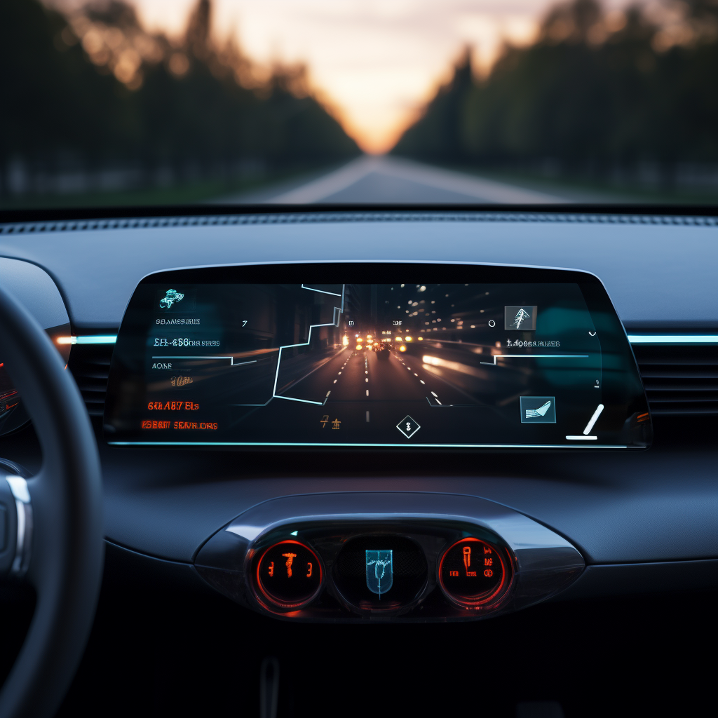
However, there is a huge gap between logic and reality: modality difference
Visionary Co-Driver
“有啥子在我前头啊？看不着啊”
The ChatGPT can 'think 'through text conversation, but it doesn’t have internal capability of perception.
Therefore, we need to provide a tool for it to "read" the road (Road Scene Understanding).

Slide 5
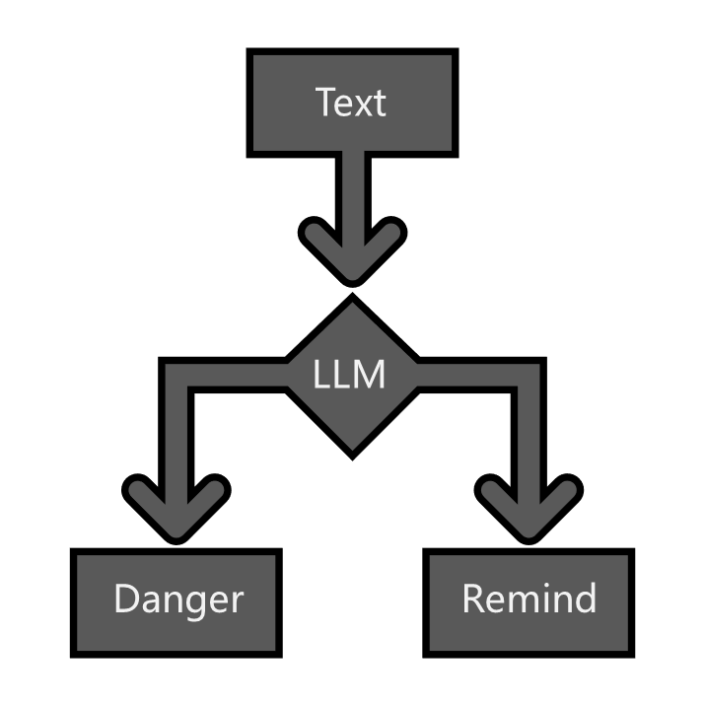
Our solution: combine SOTA models together, obtain on-road information
Visionary Co-Driver
A vision2text cascaded connected model, helping the LLM to detect the road

Slide 6
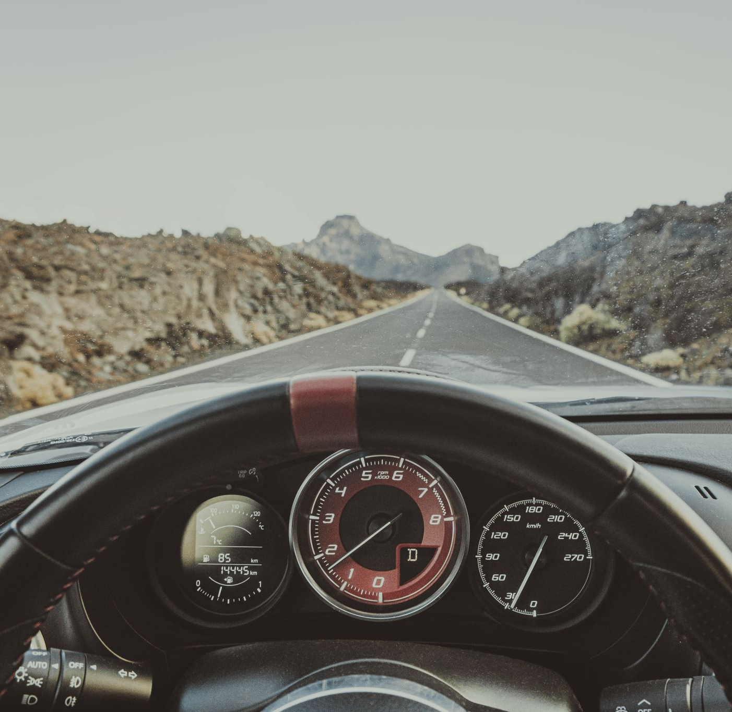
What is vision?
Visionary Co-Driver
Video + Audio
- Because we focus on driving in-car scenario, we skip audio part
Video == a sequence of frame
So, we need to firstly know what happens within a frame

Slide 7
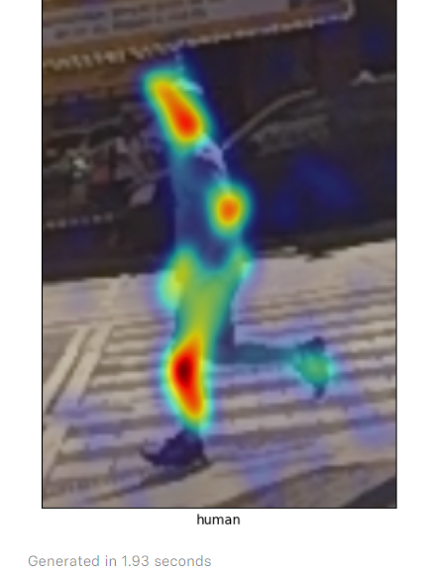
What is the Vision Feature of a pedestrian?
Visionary Co-Driver
Location: road or sidewalk? Left or right side?
Distance: near or far from us?
Speed: fast or slow?
Type: old or young?

Slide 8
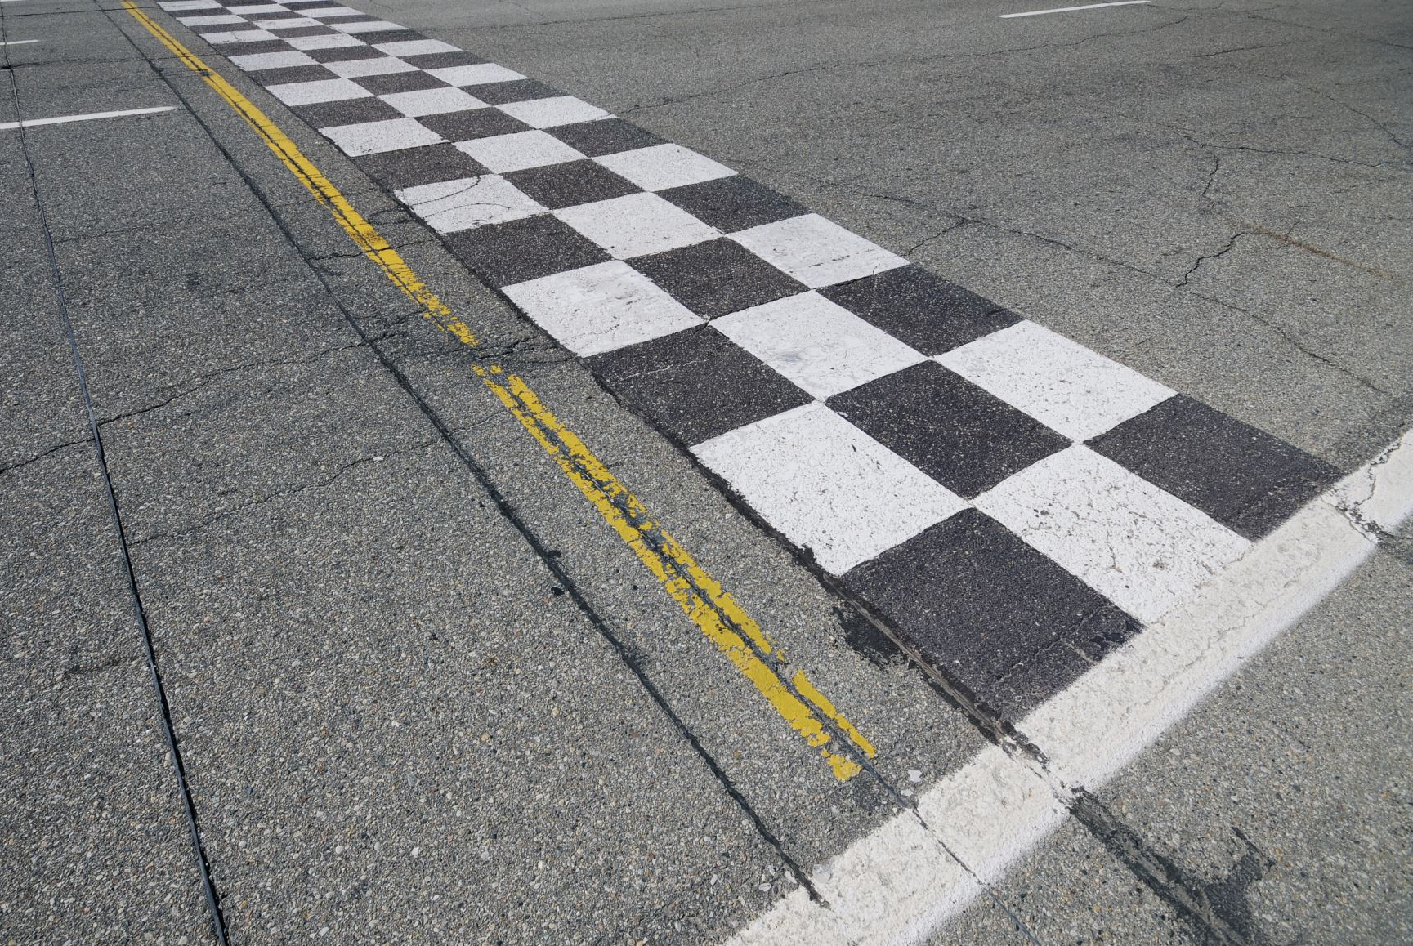
How to obtain the road / sidewalk information? Our answer: sam (not uncle)
Visionary Co-Driver

Slide 9
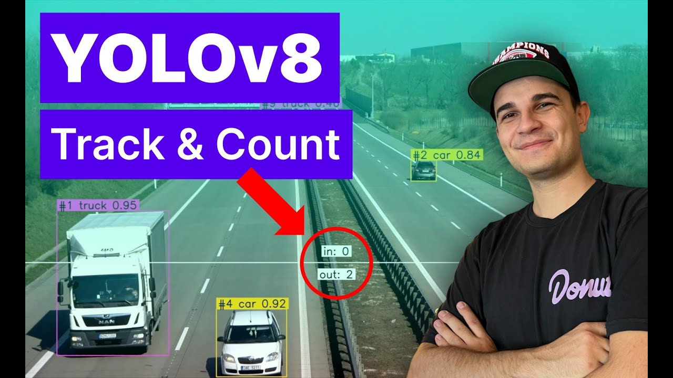
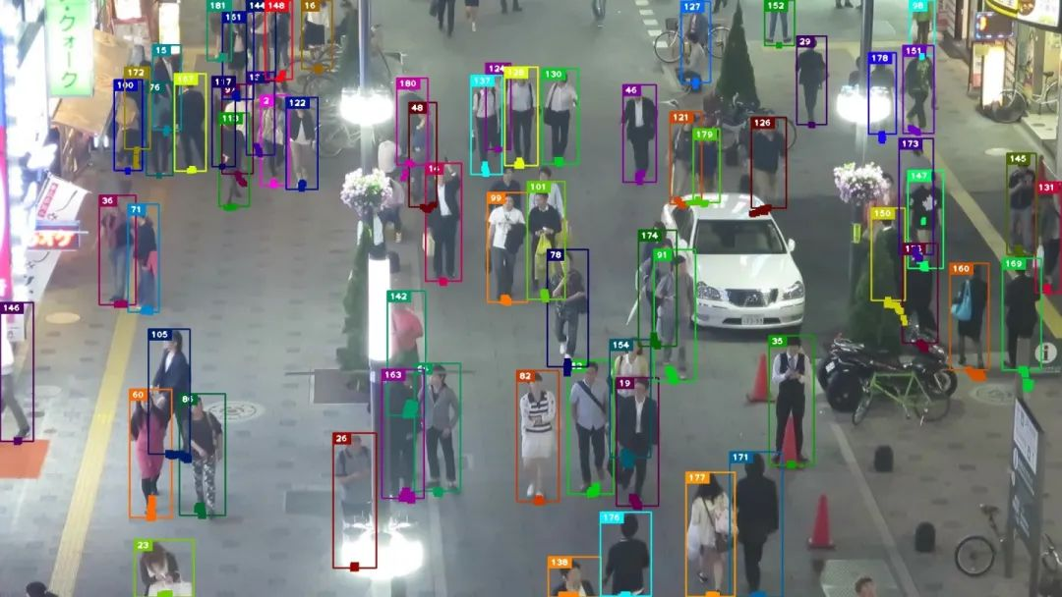
Multiple Object Tracking Yolov8+ByteTrack
Visionary Co-Driver
[2023 SOTA]
Official Support of the classic and powerful real-time CV: You Only Look Once
Fastest with GPU acceleration

Slide 10
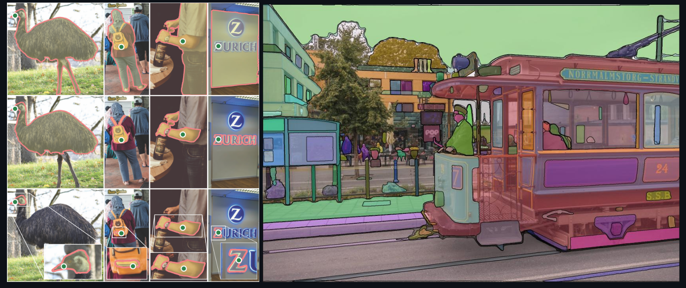
Segmentation: Segment Anything(SAM)
Visionary Co-Driver
- [2023SOTA]
- Transformer based unlabeled segmentation, SOTA zero-shot segmentation

Slide 11
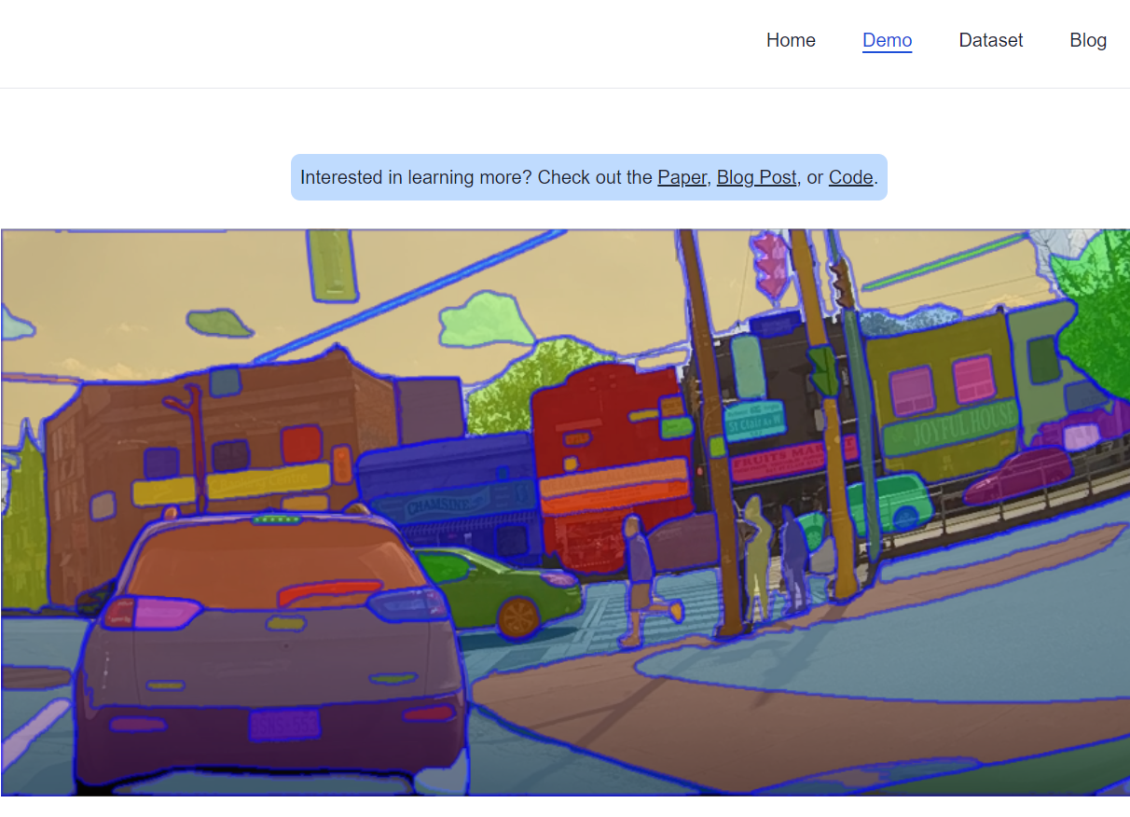
Divide the sidewalk from road
Visionary Co-Driver
After segment everything, it’s clear that all the sidewalks are shown in the image.

Slide 12
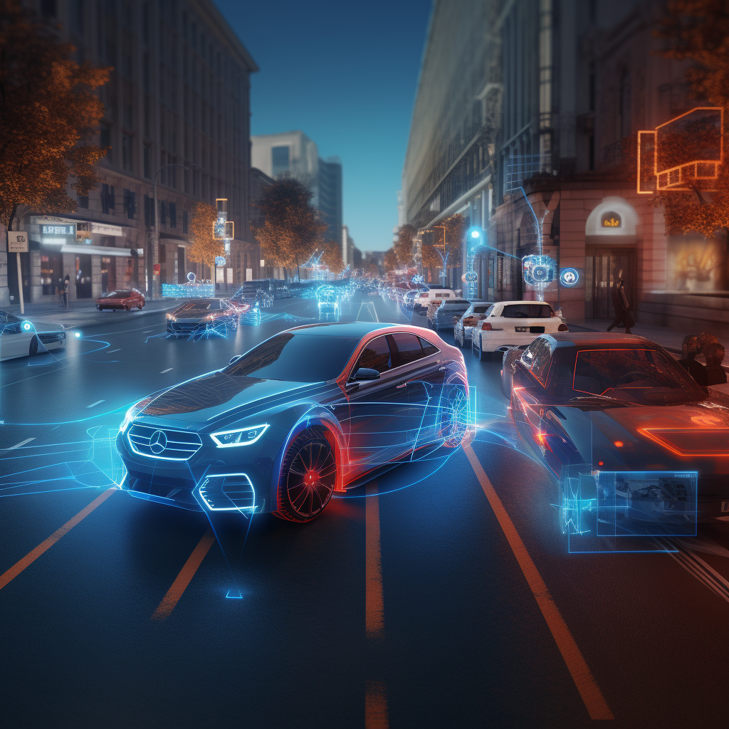
But segment everything is expensive!
Visionary Co-Driver
How can we obtain the mask information easily from SAM?

Slide 13
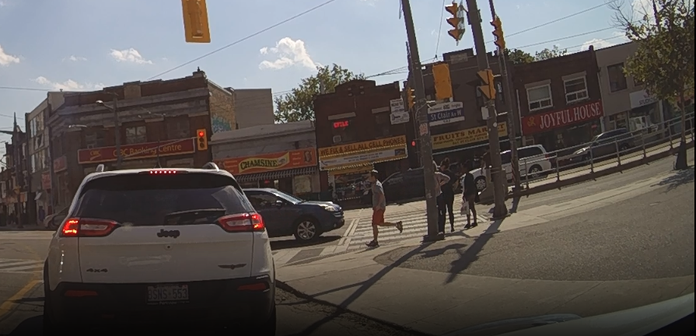
Take a review on SAM:
Visionary Co-Driver
- can generate pixel level binary mask of the image
- Can be prompted by both point and box, including positive and negative prompt

Slide 14
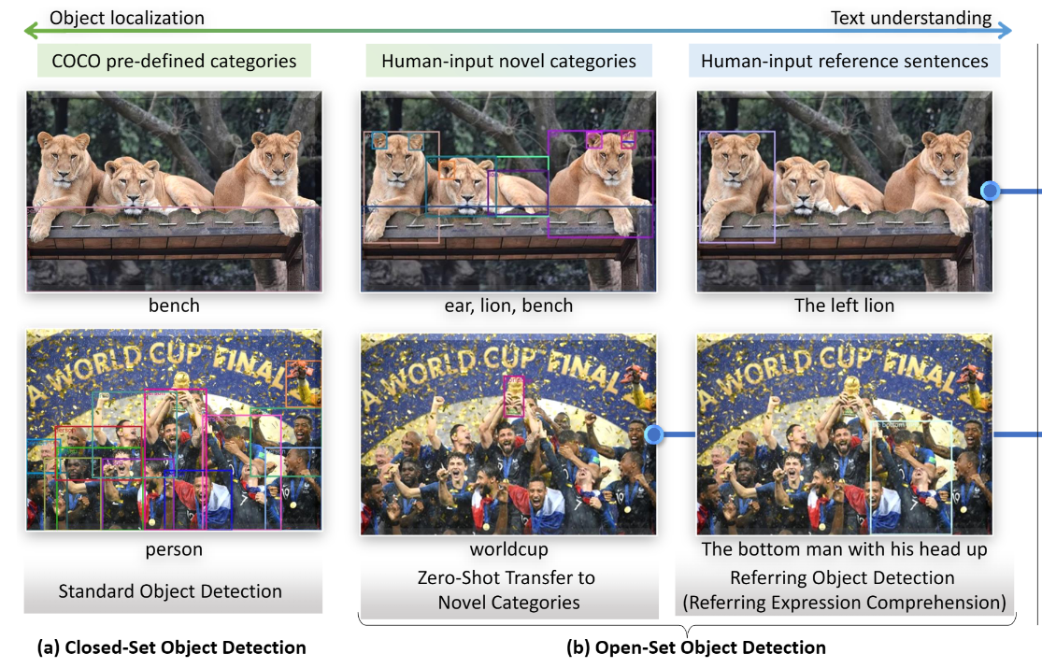
Object detection: Grounding DINO
Visionary Co-Driver
- [2022SOTA]
- Transformer based knowledge distillation, SOTA zero-shot detection.
- can generate bbox of the detected object using monocular image

Slide 15
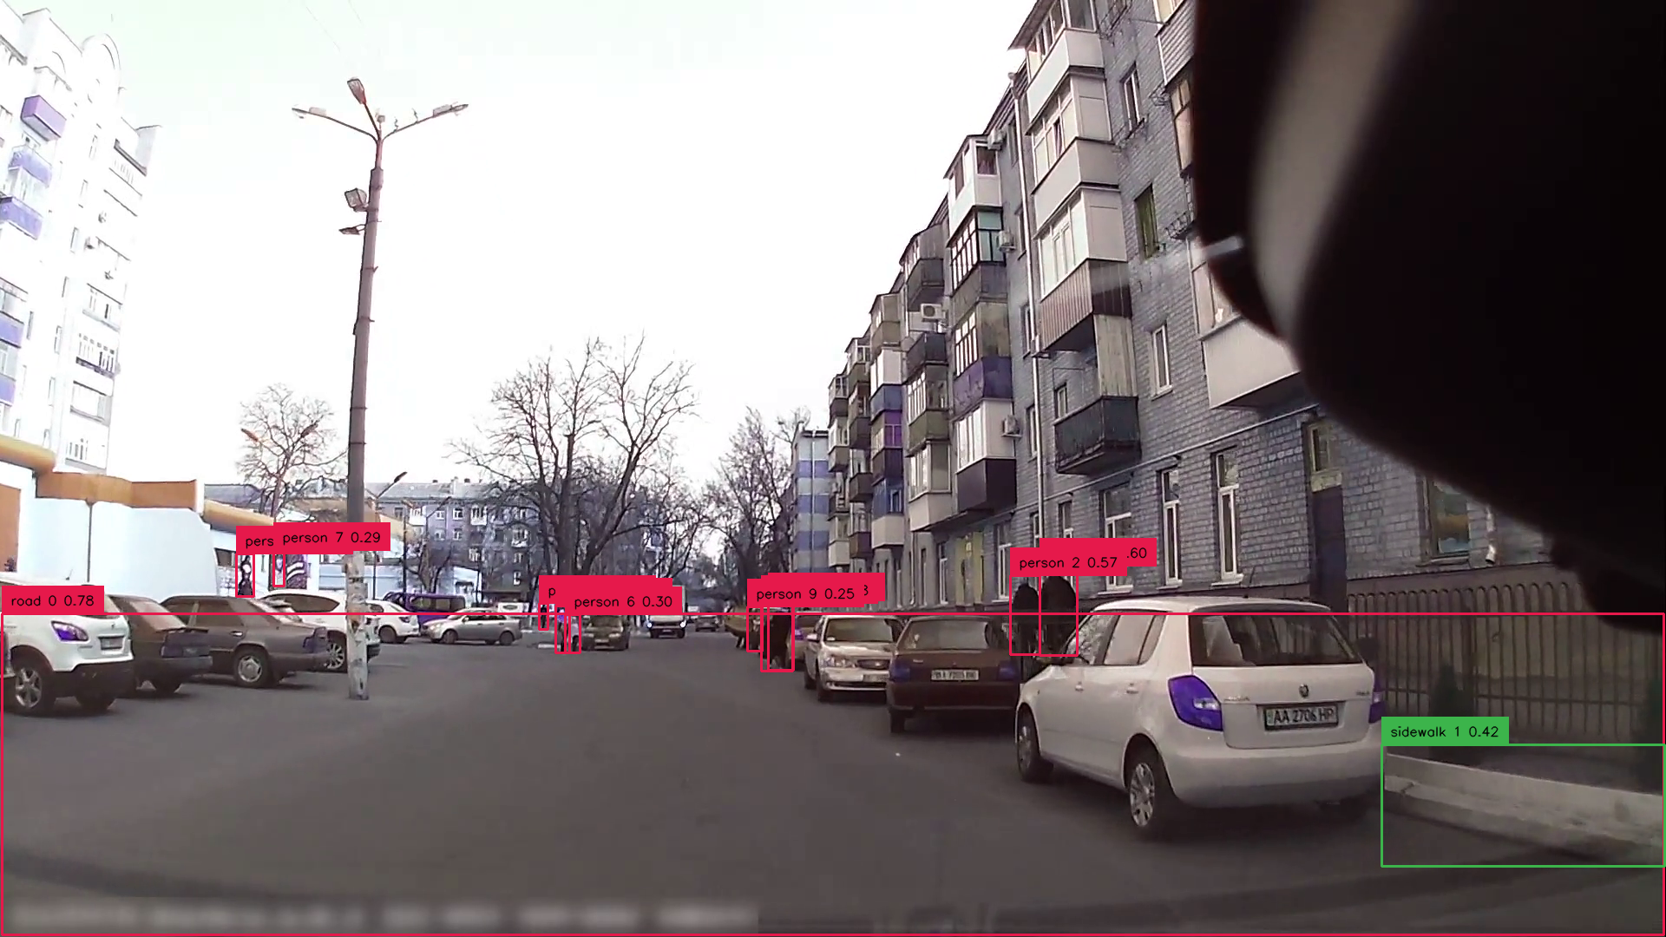
Visionary Co-Driver
Object detection: Grounding DINO
- Can be prompted based on nature language
- The gDINO can successfully recoginze the road & sidewalk using contrast prompting
- Pedestrian detection is separate, optimizing the accuracy

Slide 16
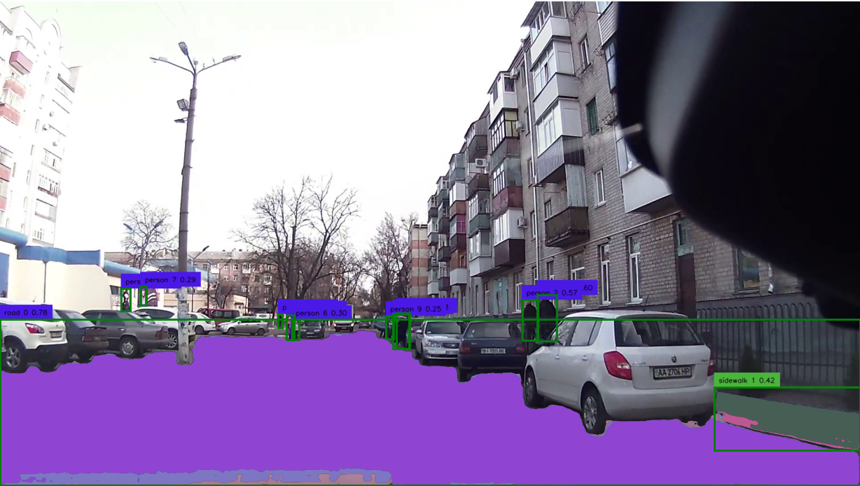
Take a review on SAM:
Visionary Co-Driver
Combining with Grounding DINO, then we realize a SOTA semantic segmentation model

Slide 17
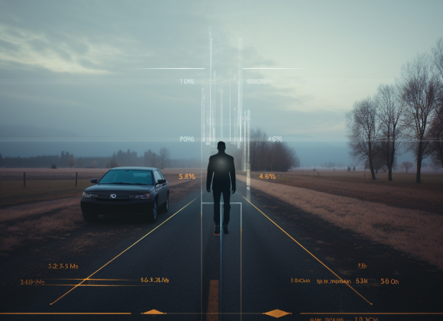
Now, how can we know the distance from pedestrian to us?
Visionary Co-Driver
In industry practice: Radar & Lidar Sensor!
But: we are poor, and we only have monocular video…

Slide 18
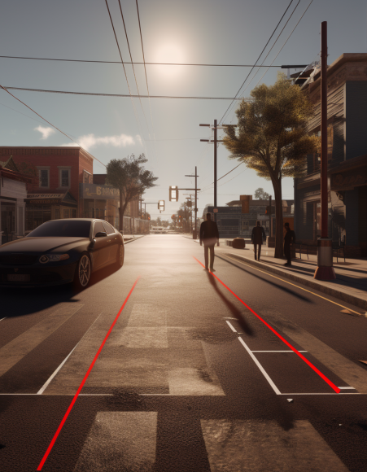
Answer: Monocular depth prediction modal!
Visionary Co-Driver
Monocular Computer Vision is powerful these days!

Slide 19
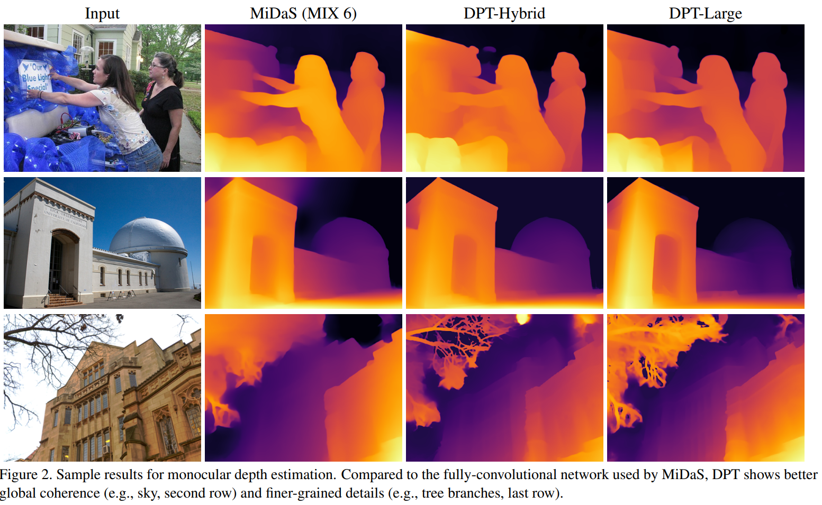
Depth estimation: Dense Prediction Transformer(DPT)
Visionary Co-Driver
- [2021SOTA]
- Transformer based monocular depth estimation
- can generate image-size NumPy array indicating the depth value of each pixel
- Based on it, we obtained the estimated distance from dashcam to object
Output: [very close, close, medium, far, very far]

Slide 20

Depth estimation: Dense Prediction Transformer(DPT)
Visionary Co-Driver
- [2021SOTA]
- Transformer based monocular depth estimation
- can generate image-size NumPy array indicating the depth value of each pixel
- Based on it, we obtained the estimated distance from dashcam to object
Output: [very close, close, medium, far, very far]

Slide 21

LLM: gpt3.5_turbo_16k
Visionary Co-Driver
- long memory, can analyze the road scene with appropriate prompting
output can be seen here (0728 version):
Summer_Research_2023/Blind_LLM_Guide_Project/Chatbot/
There was no long-context or RAG for long video.

Slide 22
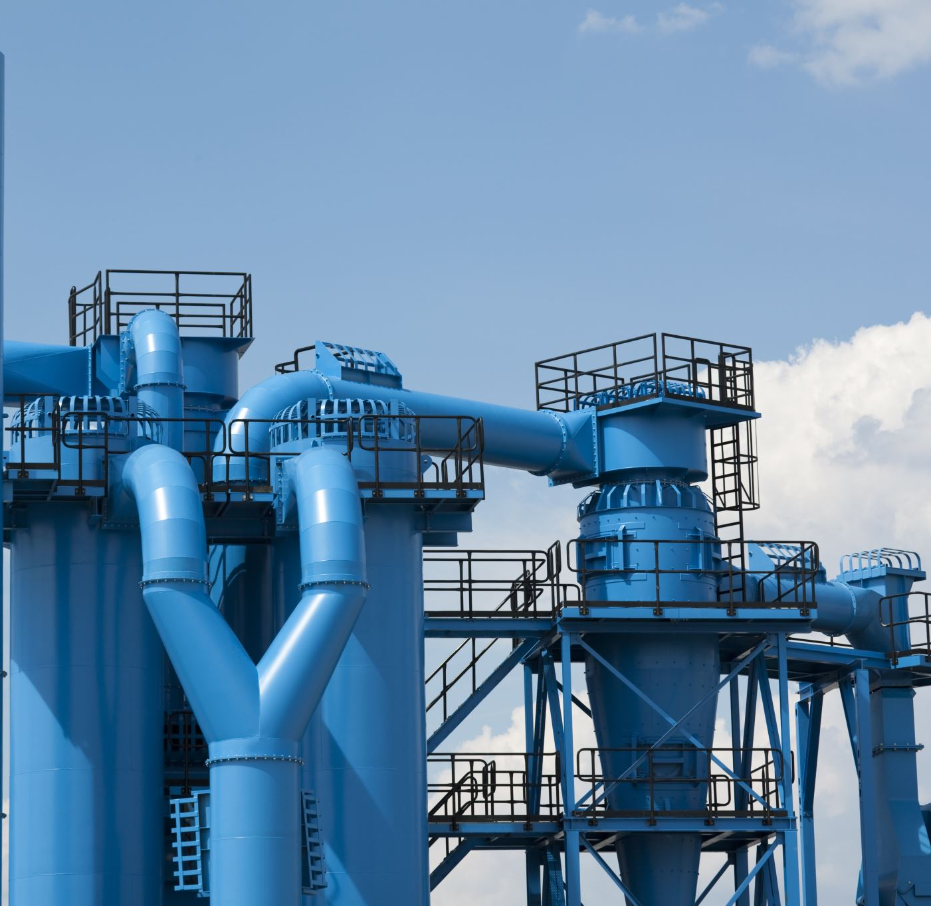
SYSTEM Design
Visionary Co-Driver
So, how do we connect those modal together into a pipeline?

Slide 23
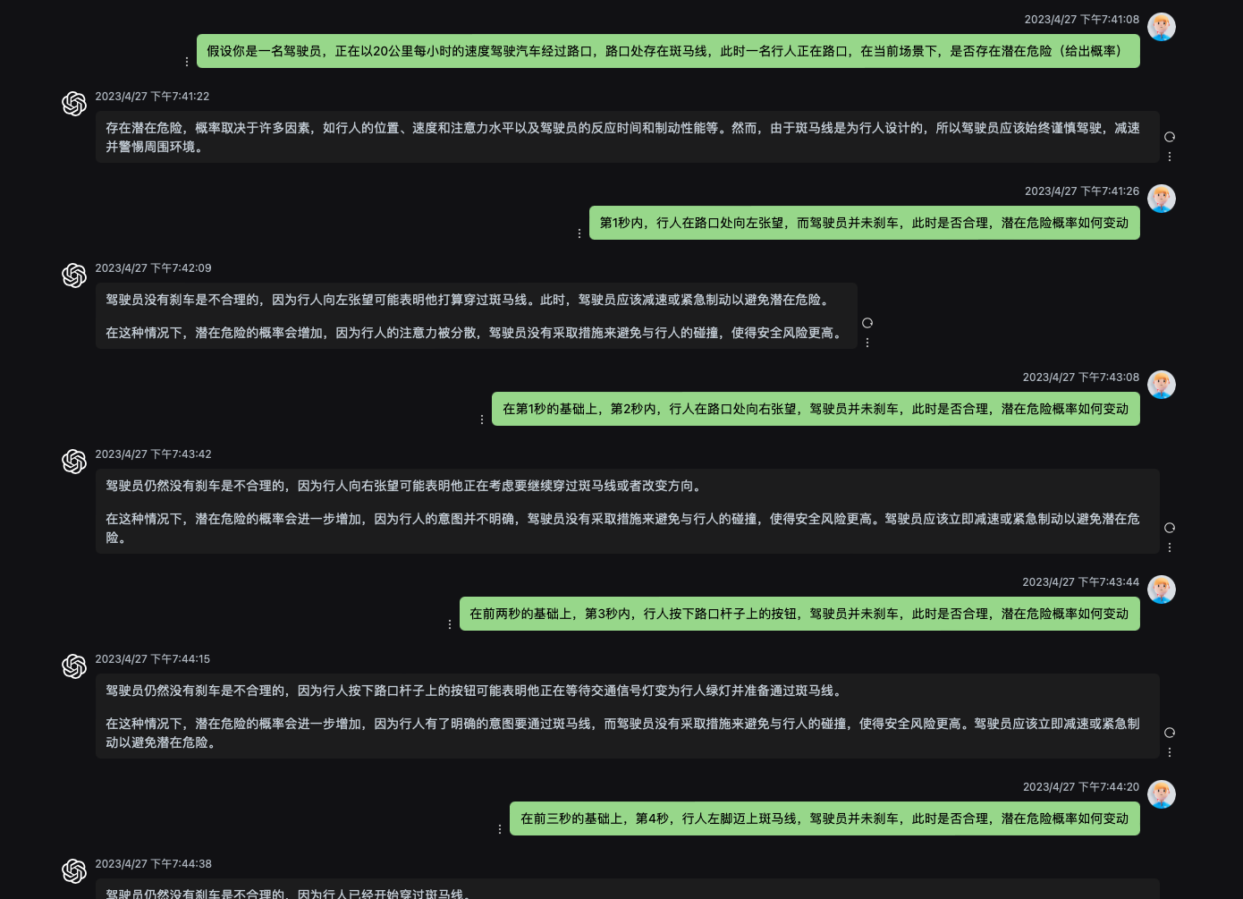
How to use LLM locate potential risk? --- Output format
Visionary Co-Driver
According to early test on LLM’s capability, it can evaluate the danger level and potential risk within the current driving scenario:
Pic: Zero-shot justification of gpt3.5 turbo

Slide 24
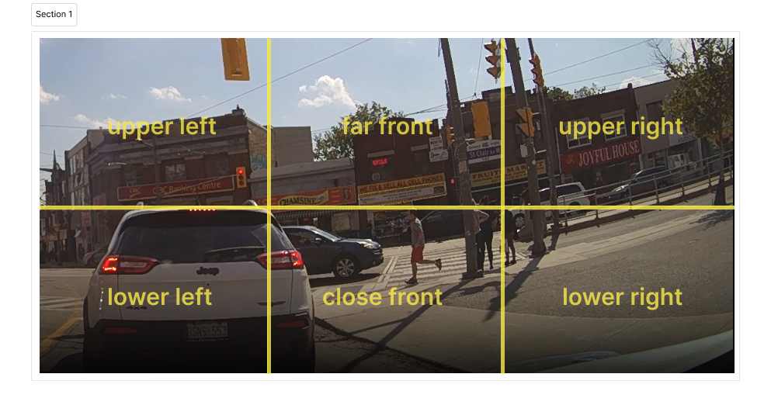
How to use LLM locate potential risk? --- Output format
Visionary Co-Driver
According to early test on LLM’s capability, it can evaluate the danger level and potential risk within the current driving scenario:
Pixel level classification, divide into 6 aspects

Slide 25
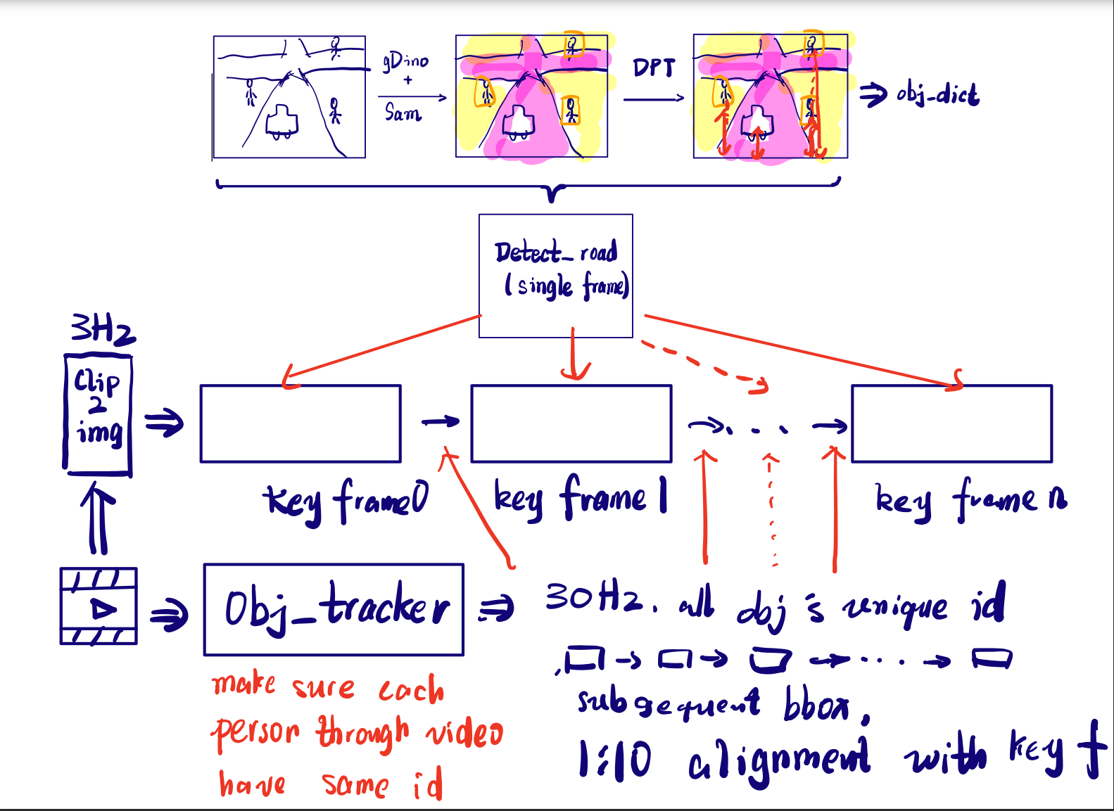
Vision2text
Visionary Co-Driver
Vision information
Obtain process

Slide 26
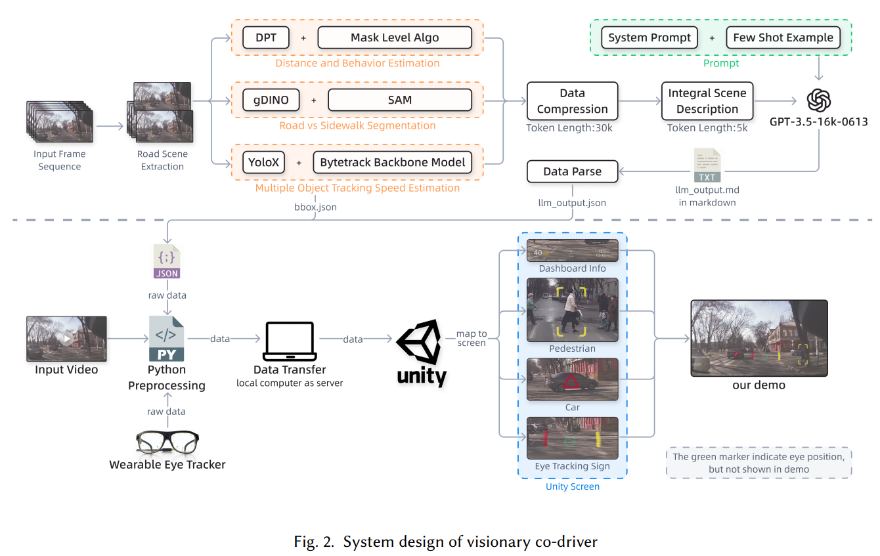
How to use LLM locate potential risk? --- Output format
Visionary Co-Driver
Our solution: 关键帧+混合帧分析
Furthermore, how can we demonstrate it in: - Vision: ARHUD
- Unity enhanced Video
Notes:
输出要说清楚，怎么交代给

Slide 27
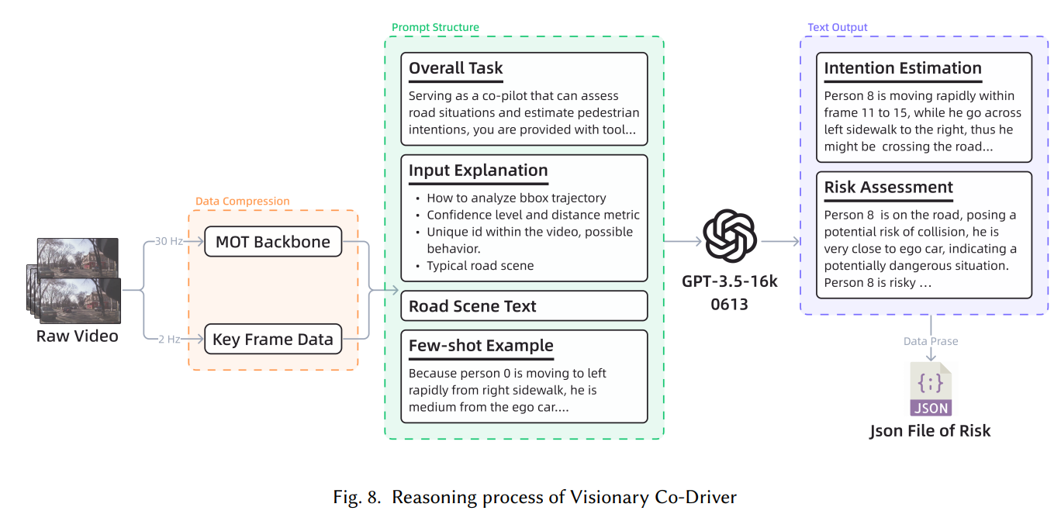
Vision2text
Visionary Co-Driver
Text generation process

Slide 28
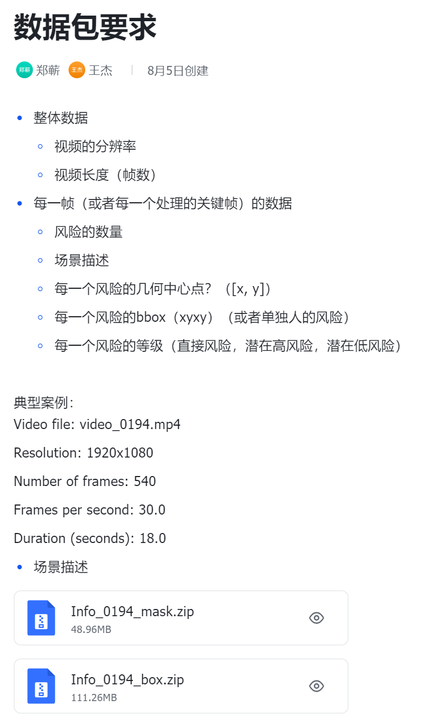
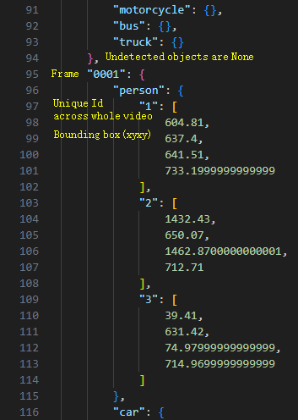
Vision2text
Visionary Co-Driver
Output format
JSON/dict form for readability

Slide 29
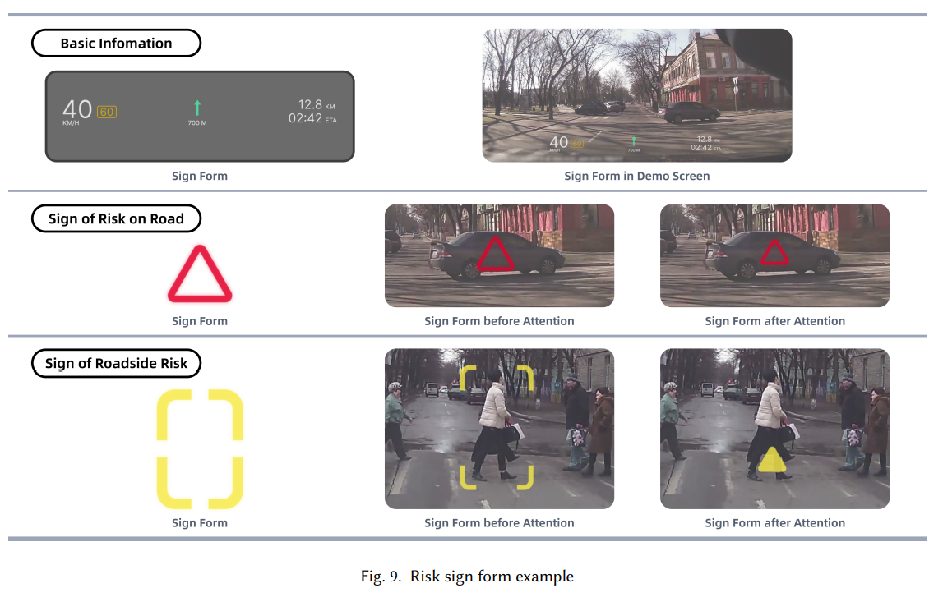
ARHUD
Visionary Co-Driver
Augmented Reality Heads-Up Display (AR-HUD) interfaces

Slide 30
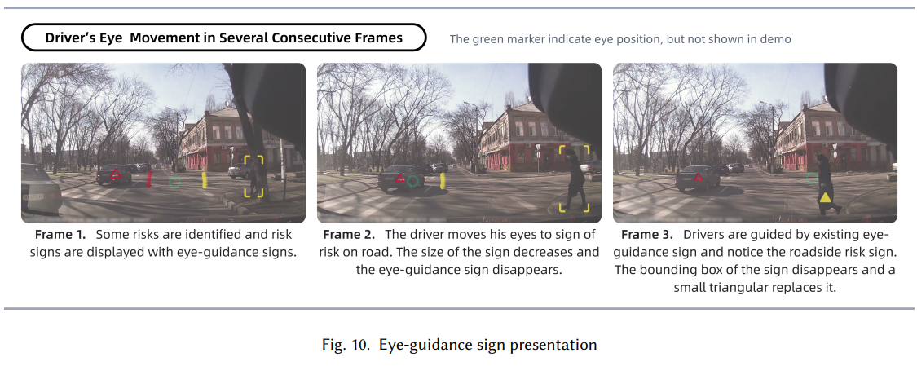
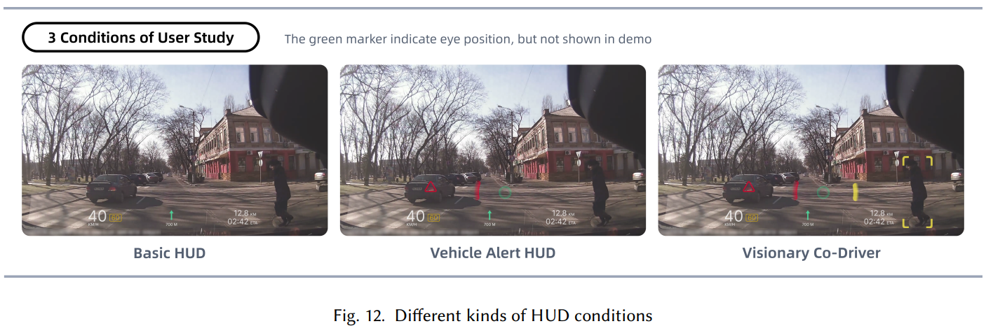
ARHUD
Visionary Co-Driver
Augmented Reality Heads-Up Display (AR-HUD) interfaces

Slide 31
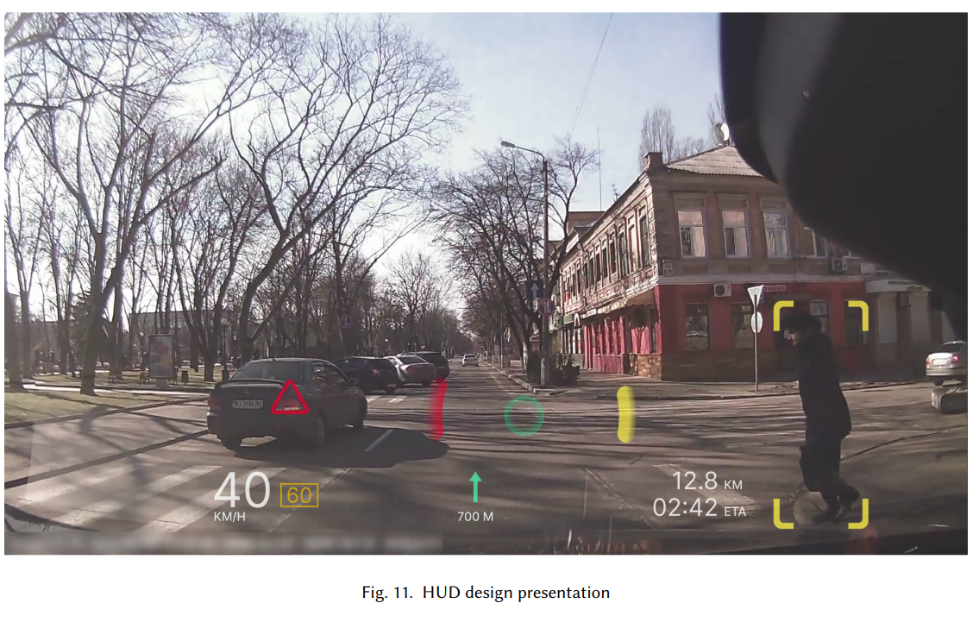
ARHUD
Visionary Co-Driver
Augmented Reality Heads-Up Display (AR-HUD) interfaces

Slide 32
Another basic problem: how to test the model?
Visionary Co-Driver
It occupies a lot of time to do simulation and real-life testing So, we choose video, - monocular - ground truth justification - many pedestrian

Slide 33
JAAD dataset --- the video dataset for pedestrian intention prediction
Visionary Co-Driver
What is JAAD? Joint Attention in Autonomous Driving (JAAD) Dataset.
Purpose: Developed to study pedestrian behavior, interactions, and visual cues in the context of autonomous driving.
Content:
Videos: Over 240 high-resolution video clips from different urban locations.
Annotations: Includes detailed annotations for pedestrians, such as age, gender, actions, and signals.
Scene Information: Traffic conditions, weather, lighting, etc.
Attention and Intention: Captures the complex interplay of pedestrian attention and intention.
Applications: Crucial for training models to recognize pedestrian actions, enhance traffic safety, and facilitate the development of advanced driver-assistance systems (ADAS).
Challenges: Addresses the need for fine-grained analysis, such as recognizing subtle cues from pedestrians.
Website: Link to JAAD Dataset
Notes:
后置，不是自己研究的时间顺序，而是论文的逻辑实现技术

Slide 34
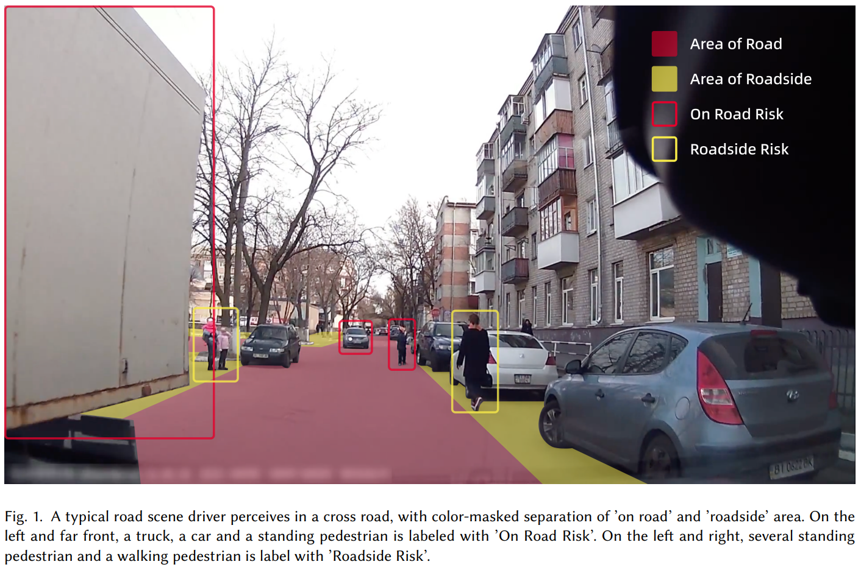
JAAD dataset --- the video dataset for pedestrian intention prediction
Visionary Co-Driver
Notes:
后置，不是自己研究的时间顺序，而是论文的逻辑实现技术

Slide 35
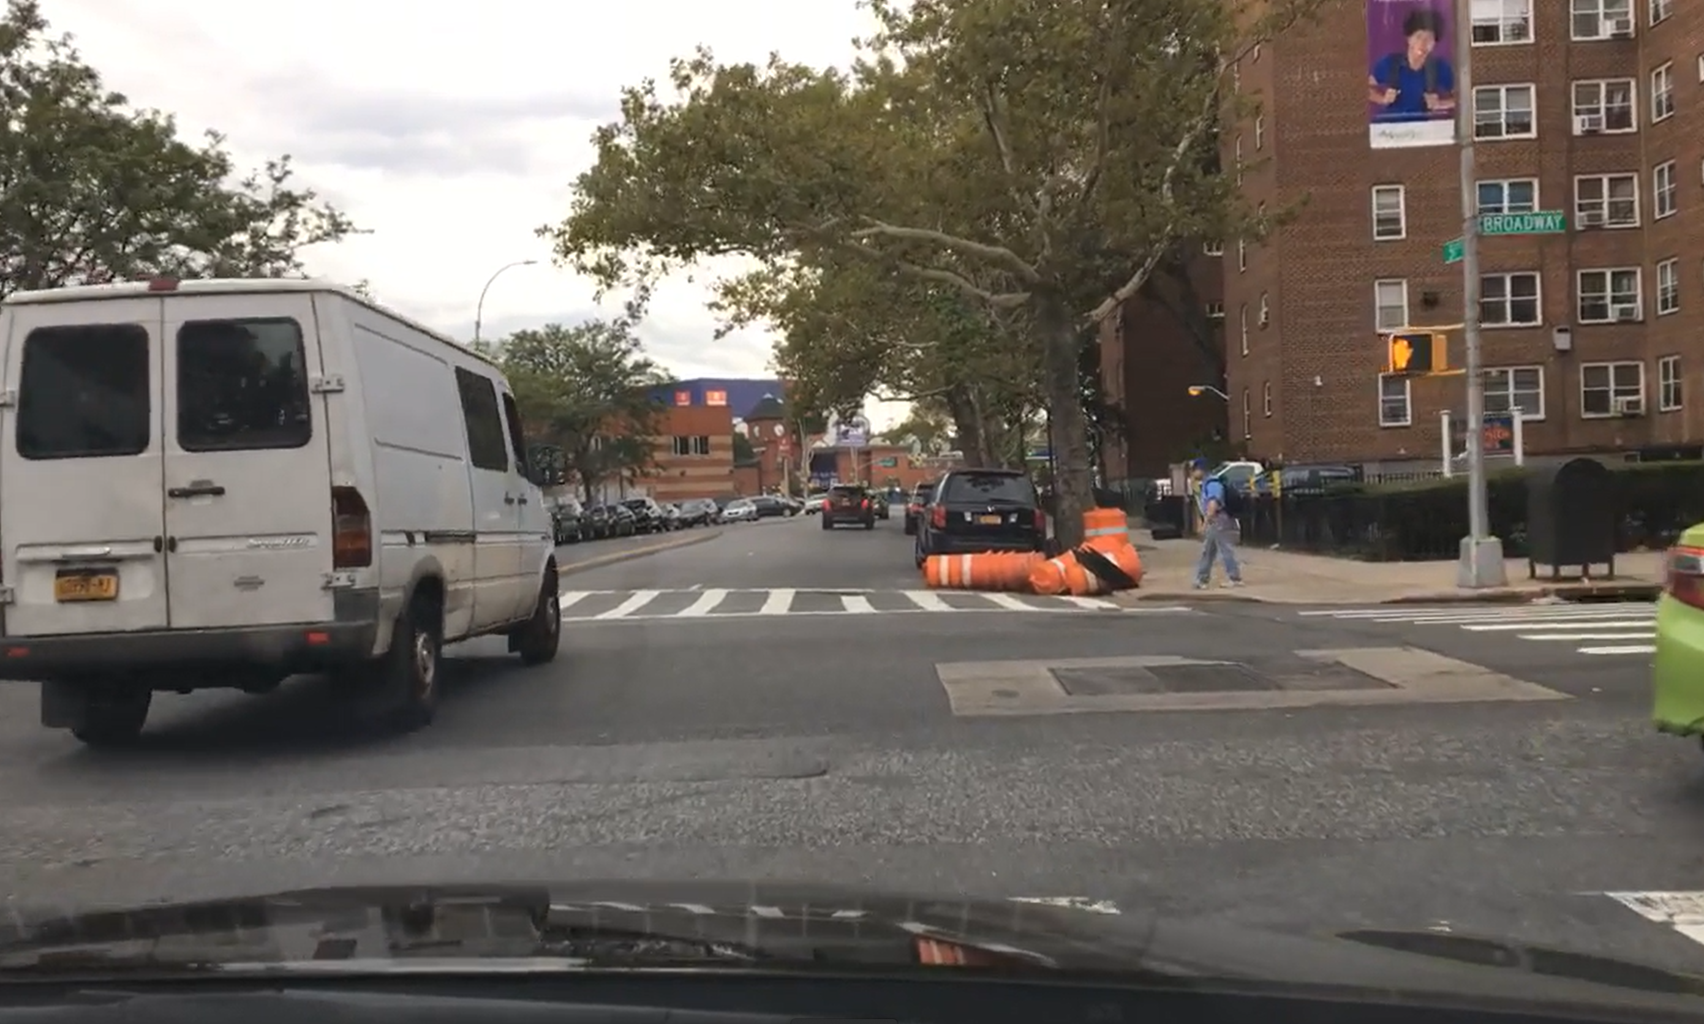
User study
Visionary Co-Driver
How do we evaluate the system in a Human-Computer Interaction Experiment?

Slide 36
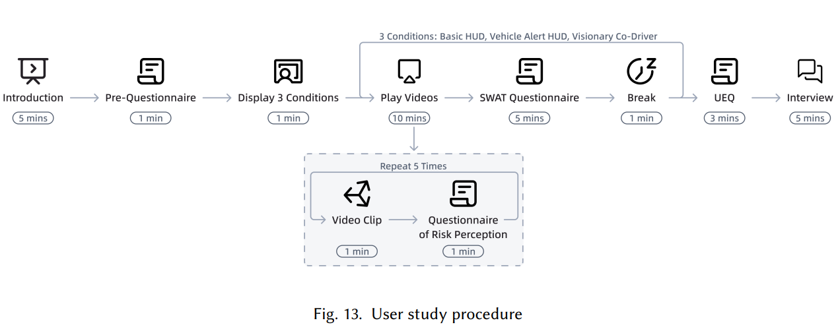
User Study Procedure (by my teammate)
Keywords: 非注意力盲视，分心，认知负荷，SWAT, UEQ
Visionary Co-Driver

Slide 37
Failure & success
Visionary Co-Driver
What did I learn from this summer research projects?

Slide 38
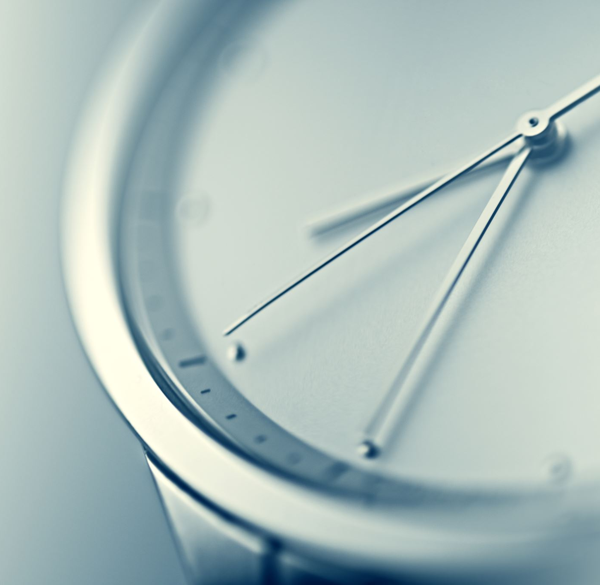
Failure Case 1 System Delay
Visionary Co-Driver
The connected model system is too slow.
Real time consideration is important,
But may be not so important
Solution:
Preprocessing for the ARHUD

Slide 39
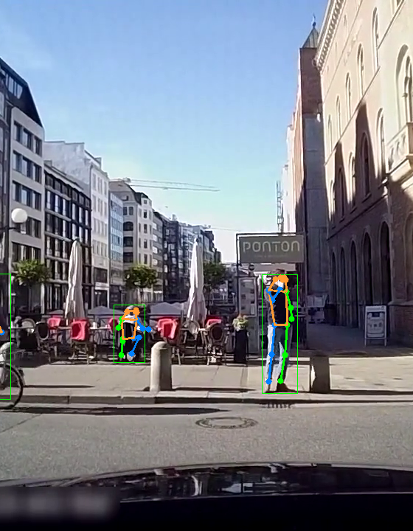
Failure Case 2 Pose Estimation
Visionary Co-Driver
I want to involve Pose direction for further explanation and description, but It is complex and quite hard to analyze the pose bone (You may still require a neural network to decide which way the man is)

Slide 40
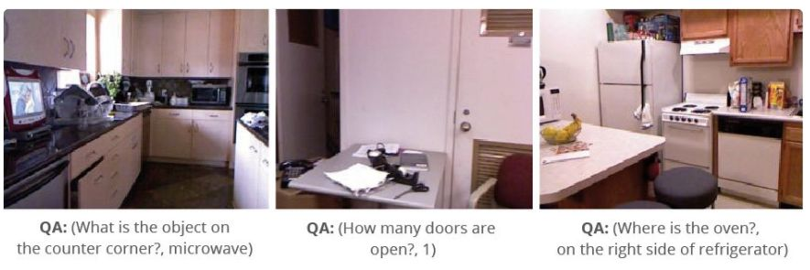
Failure Case 3: VQA(Visual Question Answering)
Visionary Co-Driver
Given a picture and text question(prompt), the model can give appropriate feed back
Natural approach of considering the vision2text task
however, it don’t work for now, too stupid. There is still not practical modal for common sense justification.

Slide 41
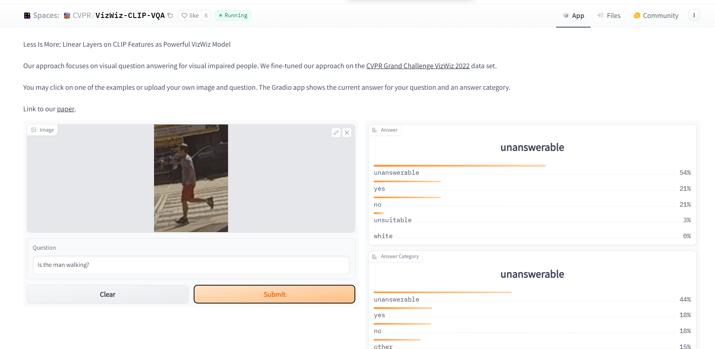
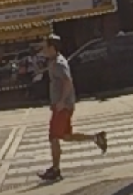
Failure Case 3: VQA(Visual Question Answering)
Visionary Co-Driver
Can’t recognize color the person is wearing
Can’t distinguish left and right
Can’t distinguish young or old
It is too unstable(50% success rate), so we don’t use it

Slide 42
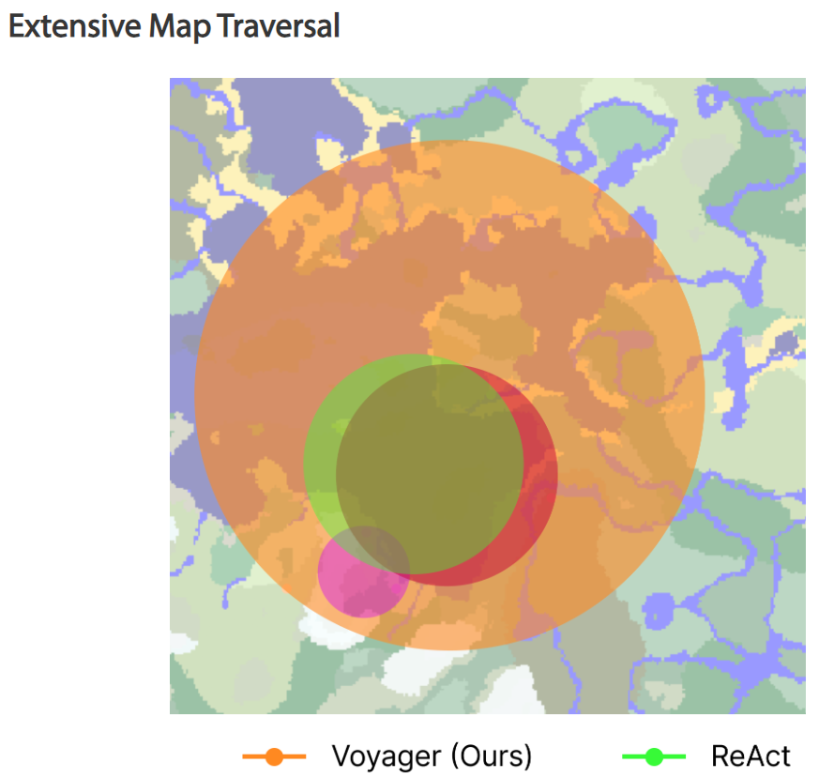
Possible IDEA: LLMs as Agent
Visionary Co-Driver
Intuition: Let GPT itself decide when to function call other api, obtain more information from the current screen.
Because
the VQA performance can be enhanced in Multiple Object scenario.
This sounds like a more ‘human-like’ behavior
Other Agent: Voyager, AutoGPT…

Slide 43

Failure Case 4
Visionary Co-Driver
Think too much about the COT
Being a big fan of AI agent like Voyager and code-interpreter, I spent a long time on this huge task. But maybe there exists a gap between personal willing and his ability. Those fancy idea requires a large team and a long time to succeed.

Slide 44

Blind, But Visionary Co-driver
Visionary Co-Driver
LLM不应该只是被动的收集信息，他应该主动调用API， 去探测前面的路口状况，让他作为一个Agent去执行分析任务
这样就可以自动化的收集信息，分析数据了
比方说可以写点segment 的API， 让他可以把一个image的interesting area/ box 切割出来，再图生文，用VQA 或者再调用现有api，输出更多的text info

Slide 45
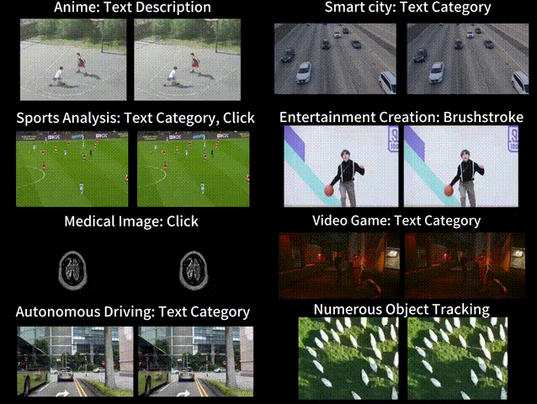
Possible Combination: Segment and Track Anything
Visionary Co-Driver
- [SOTA Mask MOT]
ZJU Work
Based on SAM and AOT(Associating Objects with Transformers, also ZJU work)
tracking and segmenting any objects in videos, either automatically or interactively.
Promptable -> gDINO for text
What a pity: Not use this earlier

Slide 46
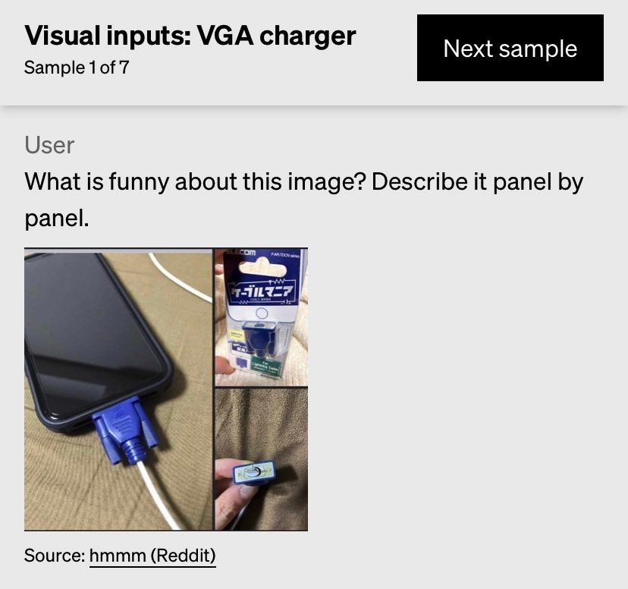
Why is our work more valuable even after visual GPT4 come out?
Visionary Co-Driver
Our Success
Vision是内含知识的，这种逻辑推理是显式的（implicit) ，我们的方案可解释性更高，而且算力需求更小（visual 如CLIP等动辄10~20s一张图）
驾驶场景的优先度，场景拆分，深入描述
All need further consideration, visual GPT4 can’t handle all the case as well

Slide 47
Some random thought: those might be useful hint
Visionary Co-Driver
Be careful of the translation! Once I misunderstand ‘人行道’ to be ‘sideroad’，which greatly lower the performance of gDINO! [prompt engineering]
- in fact: sidewalk / pavement
Treat ChatGPT as your project co-pilot with Custom Instruction, while be careful to its local optimum!
Engaging in engineering requires reading more research papers, as it makes the technical details more concise and valuable. GPT's knowledge base capability is limited, often broad but not insightful enough. If necessary, let GPT help generate keywords, and then we can search on Google Scholar ourselves.
Also, it really helps to watch tutorial sometimes. I should review Andrew Ng's ChatGPT course from time to time.

Slide 48
Some random thought: those might be useful hint
Visionary Co-Driver
5. The research ability equals engineering ability. A practical shitty draft is better than any dreamy draft. ‘Talk is cheap, show me your code.’ The way I am interested in exploring new insight is coding.
6. Meanwhile, I found it very helpful to write down the messy idea in English when I felt bad. Maybe it is because of mother tongue shame I suddenly escape from my mental local minimum.
7. Trust and collaborate with teammates on different parts of the project, like HUD design.
8. Seek Expert Opinions: Consider engaging with academics and professionals in the field for insight and potential collaboration (getting push from them)!

Slide 49
The End
Visionary Co-Driver
That’s all, thank you for listening!

